Slide 1
Detecting selection in protein-coding sequences
Stephanie J. Spielman, PhD
stephanie.spielman@temple.edu

Slide 2
All materials (and extra resources!) for my sessions live here:
sjspielman.org/lacawac2017

Slide 3
Natural selection leaves signatures of its activity in DNA
We can use phylogenetic codon models to study these signatures of selection:
Is my gene subject to positive selection?
Is my gene subject to lineage-specific positive selection?
Is my gene subject to shifts (intensification or relaxation) in selection pressure?
Are sites in my gene subject to pervasive positive selection?
Are sites in my gene subject to episodic positive selection?
Notes:
We study this information to gain insight into the biological and evolutionary processes that shape the natural world.
Hemagglutinin sequences have been studied to identify regions that are rapidly evolving, adaptive immune escape.
Shown in red. Identifying these sites contributes to rationale vaccine design so that antibodies can target the rapidly evolving regions.
Transition marked by several evolutionary patterns, such as genome reduction and reduced efficacy of NS.
Analysis here shows strength of NS is relaxed along bluer lineages, more stringent along red.
Consistent pattern where relaxed selection is commonly associated with endosymbiotic lineages.
How do we get this information? models.

Slide 4
Is my gene subject to positive selection?
Notes:
We study this information to gain insight into the biological and evolutionary processes that shape the natural world.
Hemagglutinin sequences have been studied to identify regions that are rapidly evolving, adaptive immune escape.
Shown in red. Identifying these sites contributes to rationale vaccine design so that antibodies can target the rapidly evolving regions.
Transition marked by several evolutionary patterns, such as genome reduction and reduced efficacy of NS.
Analysis here shows strength of NS is relaxed along bluer lineages, more stringent along red.
Consistent pattern where relaxed selection is commonly associated with endosymbiotic lineages.
How do we get this information? models.

Slide 5
Is my gene subject to lineage-specific positive selection?

Slide 6
Is my gene subject to shifts in selection pressure?

Slide 7
Are sites in my gene subject to pervasive positive selection?

Slide 8
Are sites in my gene subject to episodic positive selection?

Slide 9
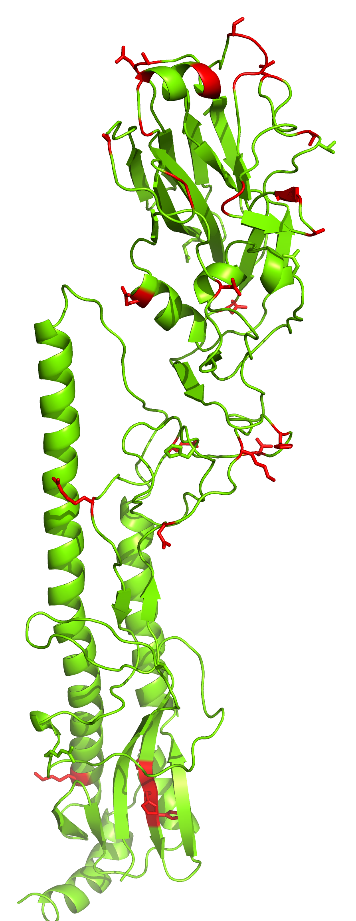
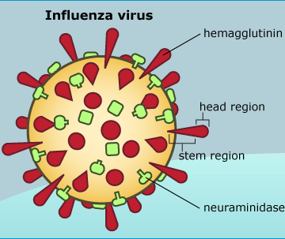
Example: Molecular evolution of pathogens
Modified from Meyer and Wilke Mol. Biol. Evol. 30: 36-44 (2013)
Notes:
We study this information to gain insight into the biological and evolutionary processes that shape the natural world.
Hemagglutinin sequences have been studied to identify regions that are rapidly evolving, adaptive immune escape.
Shown in red. Identifying these sites contributes to rationale vaccine design so that antibodies can target the rapidly evolving regions.
Transition marked by several evolutionary patterns, such as genome reduction and reduced efficacy of NS.
Analysis here shows strength of NS is relaxed along bluer lineages, more stringent along red.
Consistent pattern where relaxed selection is commonly associated with endosymbiotic lineages.
How do we get this information? models.

Slide 10
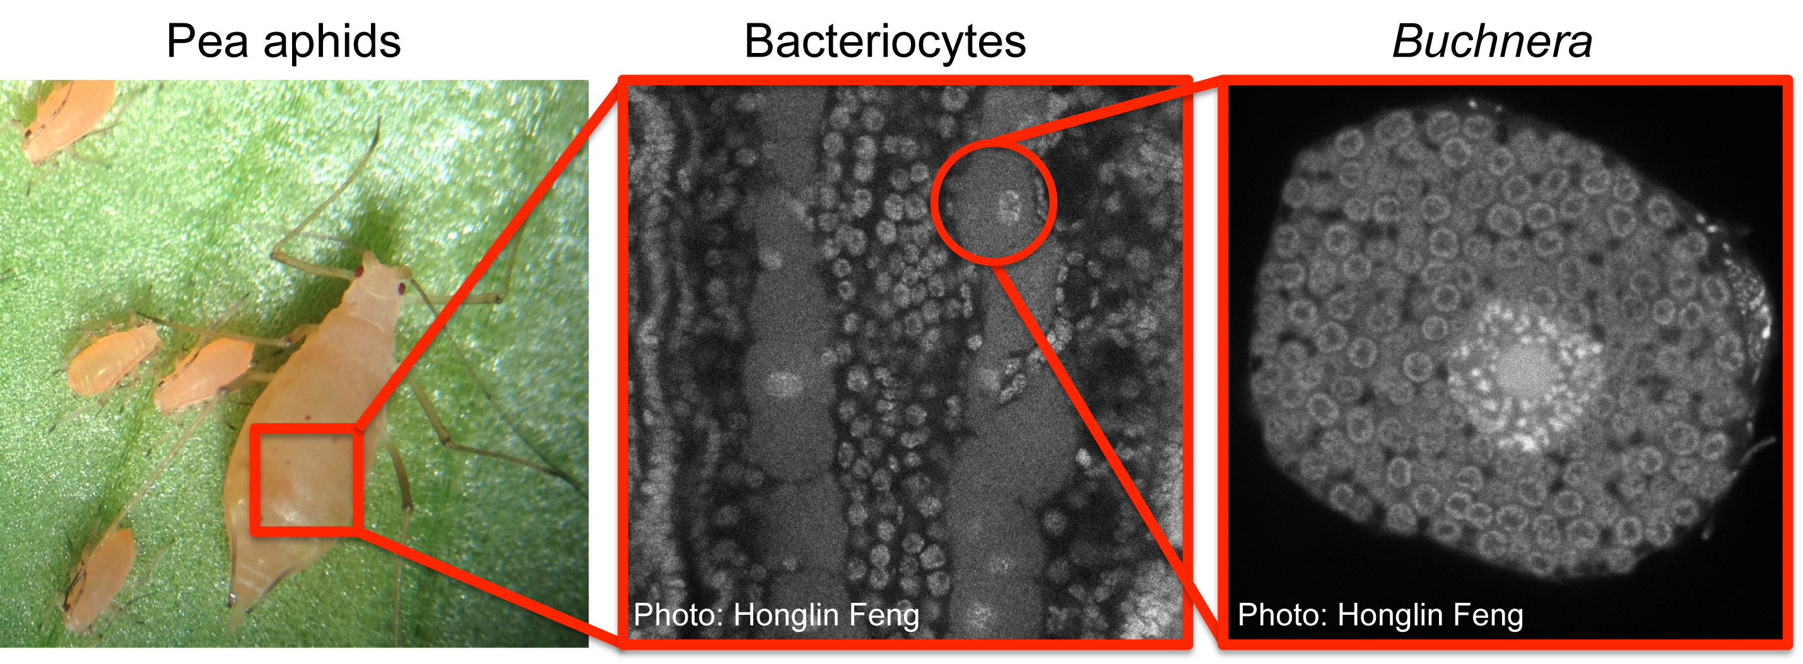
Example: Molecular evolution of major transitions
Wertheim et al. Mol. Biol. Evol. 32:820-832 (2015)

Slide 11
Example: Linking molecular evolution to life history evolution
High-performance fish vs. Sedentary fish
Faster mitochondrial evolution in high-performance fish than sedentary fish
Strohm, Gwiazdowski, and Hanner Gene 572:27-34 (2015).

Slide 12
Example: Linking molecular evolution to phenotypic evolution
Marine chlopsid eels evolved fluorescent fatty acid-binding proteins
Eel-specific insertions
Positive selection
Gruber et al. PLOS ONE 10(11): e0140972. 2015.

Slide 13
Example: Linking molecular evolution to environmental stimuli
African starlings
Glucocorticoid receptor evolution
Ultimately, by studying the genetic architecture of stress responsiveness in wild vertebrates, we can begin to bridge the gap between proximate studies of molecular mechanisms and ultimate studies of fitness consequences in the wild.
Hofmeister and Rubenstein. Ecology Letters 19:1219—1227. 2016.
Notes:
glucocorticoid receptor gene (Nr3c1) in African starlings

Slide 14
The quick ‘n dirty of codon models

Slide 15
We fit models using a multiple sequence alignment and a corresponding phylogeny
23 612
PPARG_HUMAN CCAGAGTCCG CTGACCTCCG GGCCCTGAAA PPARG_XENLA CCCGAGTCGG CCGATCAGCG AGTCCTGAAA Q9I878_CHICK CCTGAATCTG CTGATCTGCG AGCGCTTAAG PPARG_MOUSE CCAGAGTCTG CTGATCTGCG AGCCCTGAAG
PPARG_RAT CCAGAGTCTG CTGATCTGCG AGCCCTGAAG PPARG_BOVIN CCAGAGTCTG CTGACCTCCG GGCCCTGAAG PPARG_MACMU CCAGAGTCCG CTGACCTCCG GGCCCTGAAA PPARG_RABIT CCCGAGTCTG CCGACCTCCG GGCCCTGAAG PPARB_XENLA CCA---GTGT CTGACTTGGA TGTTCTACAG

Slide 16
We generally use dN/dS-based codon models to infer selection
dN = nonsynonymous substitution rate
dS = synonymous substitution rate
AGT → CGT
M R
CGC → CGT
R R
dN/dS < 1 | Purifying selection
dN/dS ~ 1 | Neutral evolution
dN/dS > 1 | Positive selection

Slide 17
We model sequence evolution as a Markov process
A Markov Process has a specified set of states
Nucleotide: A C G T
Amino acid: A C D E F G H I K L M N P Q R S T V W Y
Codon: AAA, AAC, AAG, ..., TTT
Markov processes are memory-less
Transitions between states occur with a probability that depends only on the current state
Evolution acts on current genotype/phenotype, not on ancestral or future
Notes:
say time-reversible

Slide 18
We model sequence evolution as a Markov process
A Markov Process has a specified set of states.
Nucleotide: A C G T
Amino acid: A C D E F G H I K L M N P Q R S T V W Y
Codon: AAA, AAC, AAG, ..., TTT
Markov processes are memory-less
Transitions between states occur with a probability that depends only on the current state.
P(G|A)
P(G|A)
... T → A → G → T → C → A → G → ...
Time
Notes:
say time-reversible

Slide 19
From populations to Markov chains
time
Assumption that differences among sequences are fixed differences, i.e. substitutions

Slide 20
A codon model is a 61x61 matrix
AAA AAC AAG AAT ACA … TTT
AAA
AAC
AAG
AAT
ACA
…
TTT
AAA→ AAG
synonymous transition:
r_{AG} * F_{<G,AAG>}
AAG→ AAT
nonsynonymous change:
r_{GT} * ⍵ * F_{<T,AAT>}
ACA→ AAC
Rate = 0 when
2 nucleotide changes
r_{ij} = exchangeability (mutation model)
⍵ = dN/dS parameter
F_{j} = Frequency of target codon (GY94)
OR frequency of target nuc (MG94)

Slide 21
Brief detour: Mutation-selection models
The newest flavor of codon models (not dN/dS!) model substitution mechanistically
Substitution rate = mutation rate * fixation rate

Slide 22
These models are only suitable for interspecific data and pathogens.
Caution!

Slide 23
Using HyPhy to detect selection
Homepage: http://hyphy.org
Datamonkey webserver: http://datamonkey.org
New Datamonkey webserver: http://test.datamonkey.org

Slide 24
Hypothesis testing methods we’ll look at today
Is my gene subject to positive selection sometime, somewhere? BUSTED
Is my gene subject to lineage-specific positive selection? aBSREL
Is my gene subject to shifts (intensification or relaxation) in selection pressure? RELAX
Are sites in my gene subject to pervasive positive selection? FEL
Are sites in my gene subject to episodic positive selection? MEME

Slide 25
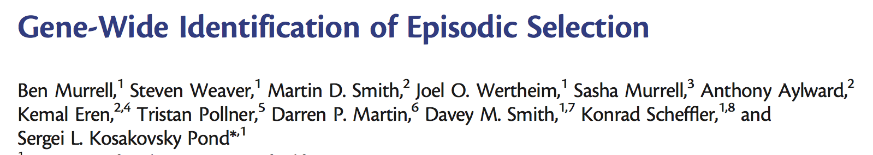
BUSTED
Null Model | Alternative Model
⍵₁ ≤ ⍵₂ ≤ 1 = ⍵₃ | ⍵₁ ≤ ⍵₂ ≤ 1 < ⍵₃
Specify foreground and background branches
Fit null model to all branches, pooling all sites
Fit alternative model to foreground to test for selection on the foreground

Slide 26
BUSTED
If significant, then there is evidence that the gene has evolved under positive selection at some time, on some sites, along the foreground branches.
Excellent for low-power situations

Slide 27
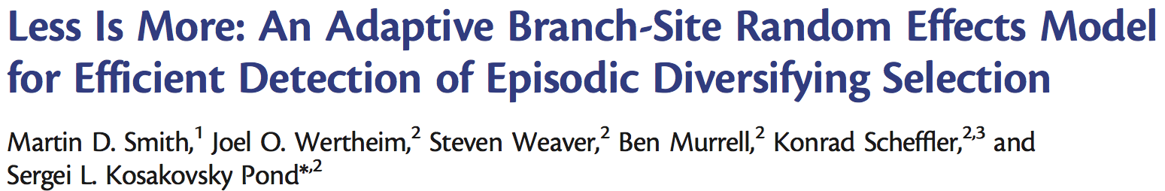
aBSREL
Null Model | Alternative Model
All ⍵ values ≤ 1 | ⍵ values are unconstrained
For each branch, determine the optimal number of ⍵ categories
If the alternative model has any ⍵ > 1, compare to null fit
Correct for multiple testing across branches

Slide 28
aBSREL
If a given branch significant, then there is evidence that some percentage of sites along the branch have evolved under positive selection.

Slide 29
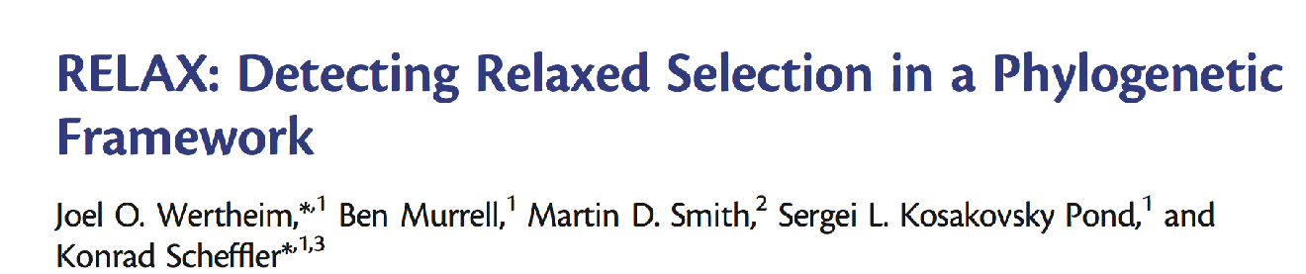
RELAX
Null Model | Alternative Model
⍵_{<1,2,3>} | ⍵_{<1,2,3>}^{k}
Specify reference and test branches
Fit null model to all branches, pooling all sites
Fit alternative model to test branches to test for shifts in selection stringency

Slide 30
RELAX
If test is significant..
If K < 1, there is evidence that selection has been relaxed on the test branches.
If K > 1, there is evidence that selection has been intensified on the test branches.

Slide 31
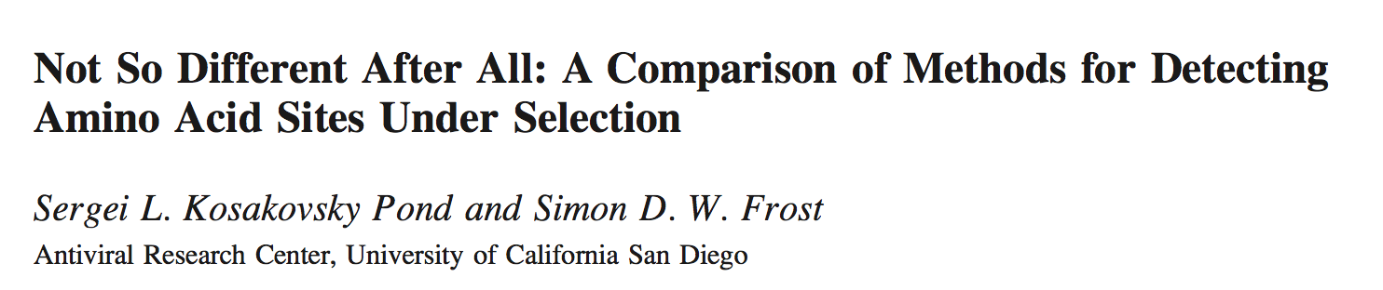
FEL
Null Model | Alternative Model
⍵ = 1 or dN = dS | ⍵ != 1 or dN != dS
Infer dN and dS (or single ⍵) at each site
Test dN=dS (or ⍵=1) at each site

Slide 32
FEL
If test is significant..
If dN > dS (or ⍵ > 1), then there is evidence for positive selection at this site.
If dN < dS (or ⍵ < 1), then there is evidence for purifying selection at this site.

Slide 33
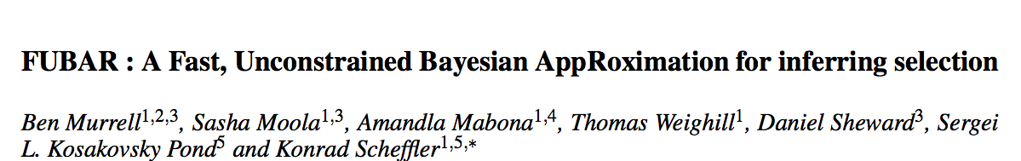
Brief detour: FUBAR
Essentially (but statistically not really) FEL but for BIG datasets (ie 10,000!)

Slide 34

MEME
Null Model | Alternative Model
dS ≤ dN₁ and dS ≤ dN₂ | dS ≤ dN₁ and dN₂ is unconstrained
Fit a single dS and two dN values per site (each with some weight summing to 1)
Compare fit between constrained (null) and unconstrained (alt) second dN category

Slide 35
MEME
If test is significant, then there is evidence that the given site has evolved under episodic positive selection. We don’t know which branches, though!

